Slide 1


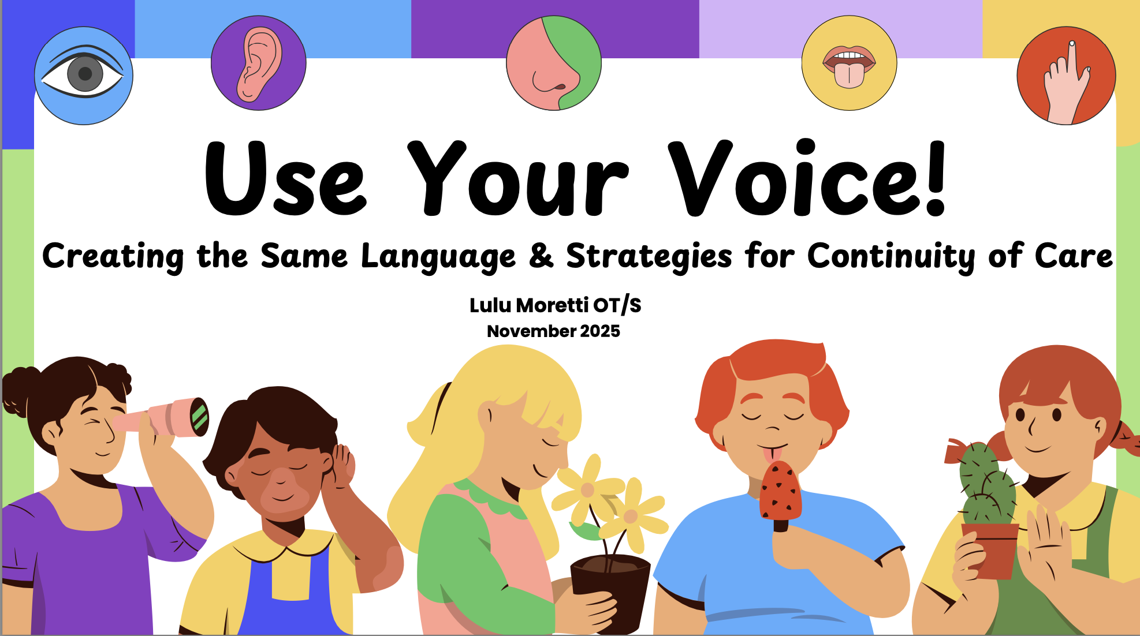

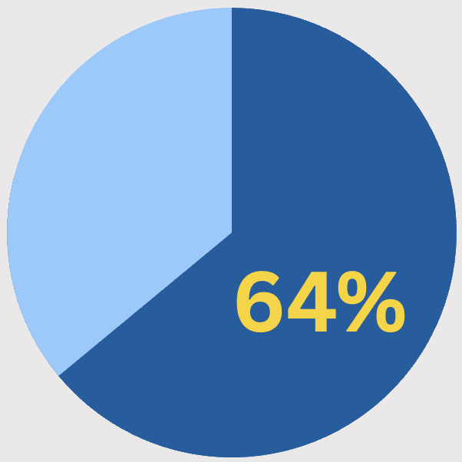
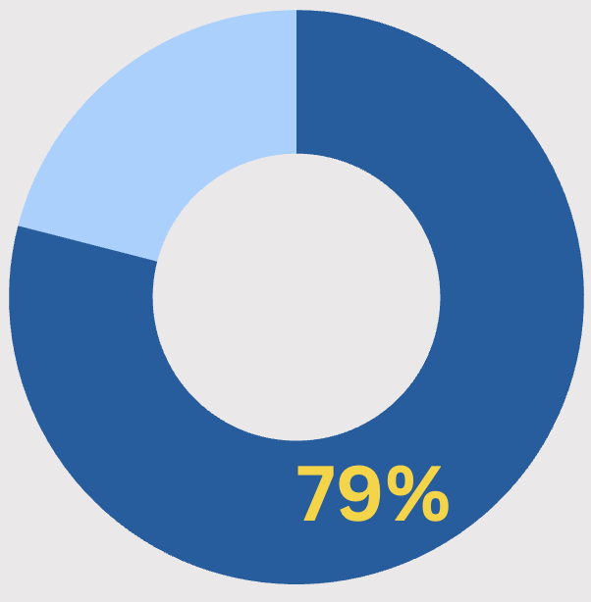
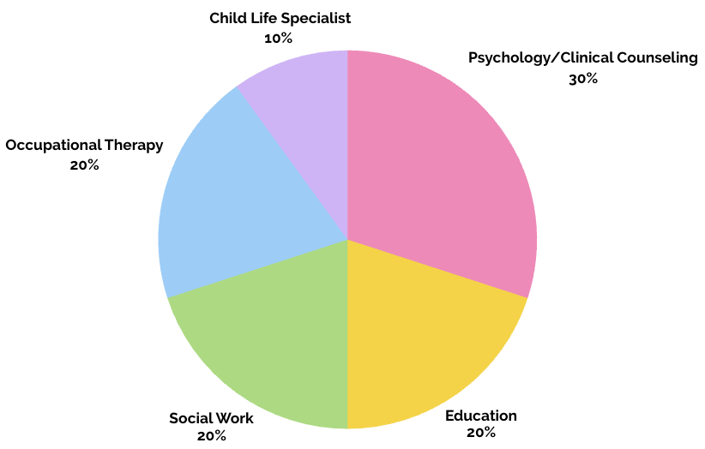

USE YOUR VOICE!
PURPOSE
CREATING THE SAME LANGUAGE & STRATEGIES FOR CONTINUITY OF CARE
Share effective, evidence-based self-regulation programs or curriculums
Unify language utilized between GLAD House and other professions involved within the child’s care team
Increase understanding of each professionals’ role within the care team
Provide glossary of resources
Lulu (Lauren) Moretti OTD/S &
Leah Dunn EdD, OTR/L
BACKGROUND
Adverse childhood experiences (ACEs) disrupt neurodevelopment, activate chronic stress responses, and impair self-regulation across childhood. As ACEs accumulate, children face increased risks for poor health, diminished well-being, and earlier initiation of substance use (CDC, 2025). Occupational therapy practitioners (OTPs) can help prevent or limit these impacts by fostering interprofessional communication and teaching shared regulation strategies that support consistent, coordinated care across home, school, community, and GLAD House. The aim of this study is to share effective strategies and language between GLAD House and other professions involved with the children’s lives to improve health decision making and self-regulation.
1 in 6 adults report experiencing 4 or more ACEs. Experiencing 4 or more ACEs increases risk of attempting suicide, have a shorter lifespan, suffer from alcoholism, and be considered a juvenile offender (CDC, 2025).
7
Average number of ACEs children at GLAD House experience (K.N., personal communication, Oct. 28, 2025)
64% of U.S. adults report experiencing at least 1 ACE before the age of 18 (Swedo et al., 2023)
79% of children who have a history of maltreatment, including abuse or neglect, have a sensory processing dysfunction (Howard et al., 2019).
METHODOLOGY
BACKGROUND OF INCLUDED
RESULTS
IMPLICATIONS FOR OT &
PARTICIPANTS
CONCLUSIONS
DESIGN
Semi-structured recorded and transcribed individual interviews exploring participants’ knowledge of GLAD House, self-regulation strategies, roles in children’s lives, and information needs. Open-coding of transcripts used to find themes and inform creation of educational module.
Included participants had the following educational backgrounds:
3 psychology/clinical counseling, 2 social work, 2 education, 2 occupational therapists, and 1 child life specialist
An educational module was created based on the interviews. Educational module topics included:
  Background & implications of experiencing ACEs
  Dan Siegel’s Hand Brain model
  Unified language
  Glossary of each professions’ role within the child’s care team
  Sensory systems education
  Self-Regulation Strategies
      Interoception
      The ALERT Program/How Does Your Engine Run?
      Zones of Regulation
      Co-Regulation
  Information about GLAD House
  Glossary of community resources
OT education would benefit from more applied training and supervised practice in self-regulation interventions.
Providing ongoing training in schools, mental health programs, and community settings can improve consistency and shared language.
  OT should remain central in interdisciplinary discussions on self-regulation and sensory processing
  Pediatric OTs can strengthen team understanding by teaching accessible models
Advocacy is needed to expand reimbursement for sensory-informed interventions and ensure OT representation on interdisciplinary teams.
Policies promoting trauma- and sensory-informed environments will further support evidence-based, collaborative care for children.
RECRUITMENT
GLAD House provided a list of professionals and community partners with listed emails. Additionally, Xavier University’s OTD professors utilized their resources to share information about the Capstone project with link to scheduling an interview being included in the initial recruitment email.
PARTICIPANTS
INITIAL RECRUITMENT SENT TO 97 PROVIDERS
12 PROVIDERS SIGN UP FOR TIMESLOT
2 PROVIDERS CANCELLED INTERVIEWS
10 PROVIDERS COMPLETE INTERVIEWS
Scan for references

